Slide 1





Presented by Group 6
Topic: C program that illustrates two processes communicating using shared memory
PROGRAMMING SYSTEM ( 5 )
MEMBER
21IT413 - Pham Quoc Huy
21IT351 – Doan Duc Gia Huy
21IT279 – Doan Quoc Huy
21IT083 – Nguyen Huu Khanh

Slide 2
01
INTRODUCING SUPPORT TOOLS
02
SHARED MEMORY
03
SEMAPHORE
LIST OF CONTENTS
04
SCENARIO
05
SHARED MEMORY AREA
06
SEMAPHORE LOCK & UNLOCK
07
MESSAGE & DISPLAY
08
CHAT BOX - DISPLAY THREAD

Slide 3




SUPPORT TOOL
Oracle VM VirtualBox
OPERATION USE
Ubuntu ( Linux )

Slide 4



WHAT IS ORACLE VM VIRTUALBOX?
Free and open source virtualization software
Create and manage virtual machines
System programming and application development

Slide 5
HERE ARE SOME IMPORTANT POINTS ABOUT UBUNTU:
Open source
Community Support
UI
Version of LTS
Ubuntu Software
Widely used

Slide 6
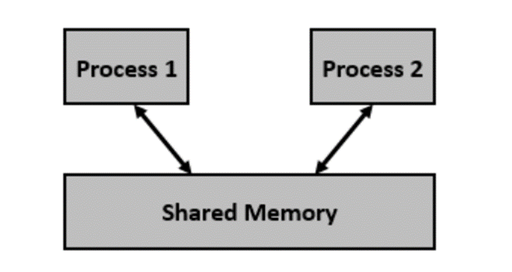
SHARED MEMORY
A technique used for IPC
A memory management technique in the Linux operating system
Allow multiple processes to share, access a portion of memory
Allows for the creation of a common data region that can be accessed by multiple process

Slide 7
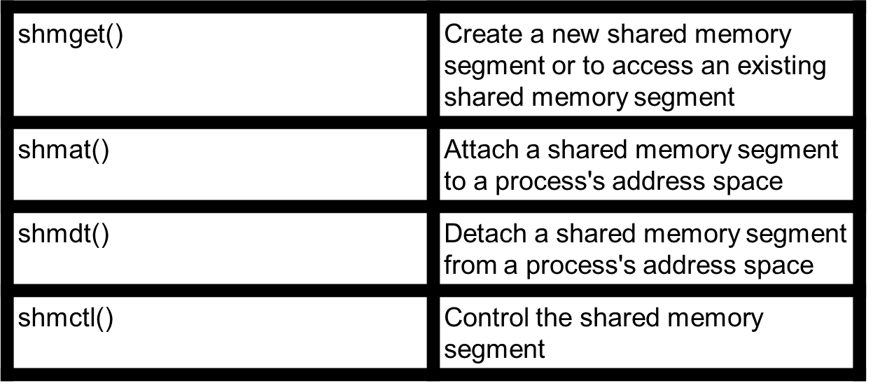
Shared Memory - Linux System calls

Slide 8
A memory management technique in the Linux operating system
Allow multiple processes to share, access a portion of memory
Allows for the creation of a common data region that can be accessed by multiple process
How to synchronize the accesses?
Need a synchronization mechanism!!!
SHARED MEMORY

Slide 9
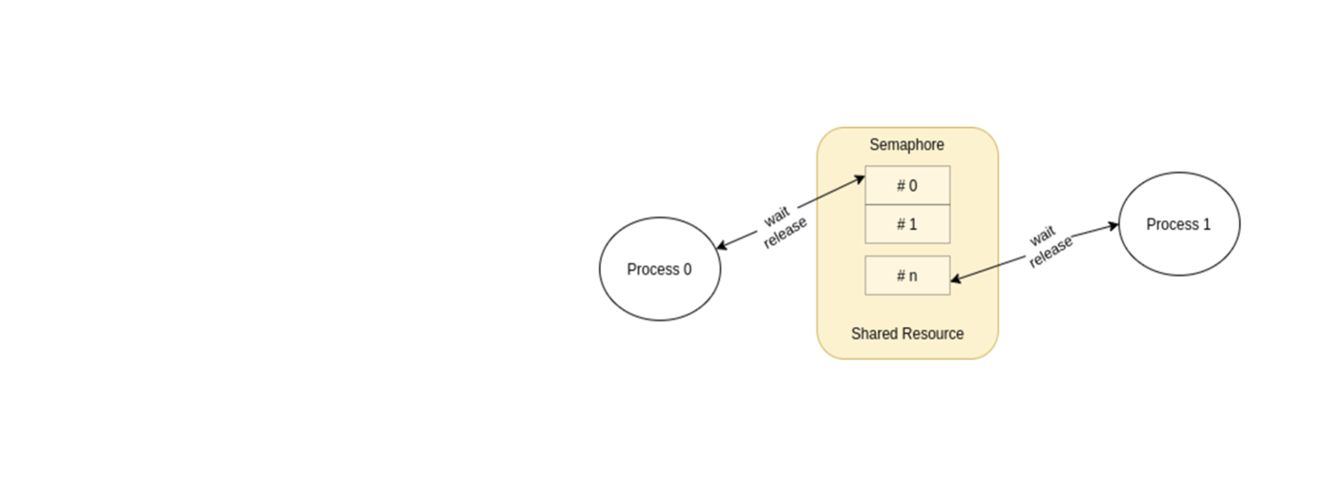
SEMAPHORE
Synchronization object
Used to control access to shared resource in multi-threaded/process environment

Slide 10
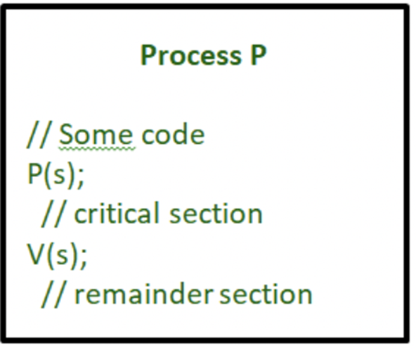
SEMAPHORE
Typically has two operation:
wait() - P()
signal() - V()
Semaphore value > 0: it decrements the value and continues the critical section
Semaphore value = 0: the process is blocked until other process finished with the resource, signals the semaphore value, wake up the blocked process
→ Semaphore can be used to synchronize Shared Memory Area

Slide 11
The chat box is where the user can chat with other users
Each user have a unique name
Each user can send message to the chat box, display received messages on the screen
SCENARIO

Slide 12
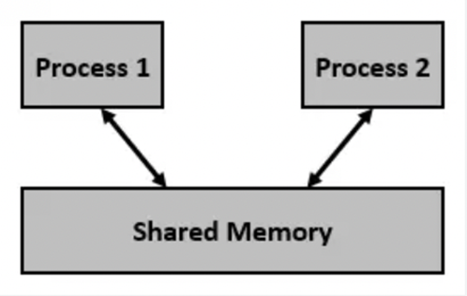
SCENARIO
The chat box is where the user can chat with other users
Each user have a unique name
Each user can send message to the chat box, display received messages on the screen
→ Basically,
The chat box is a shared memory area
Each user can create a separate process to join the chat box

Slide 13
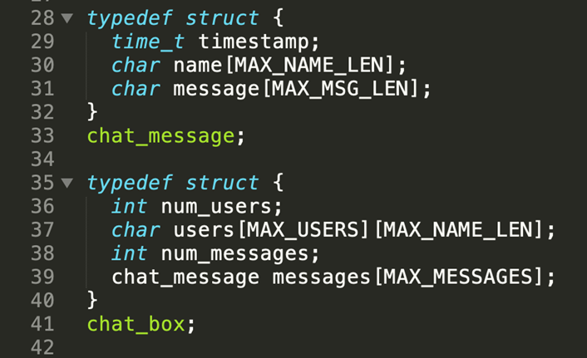
SHARED MEMORY AREA
We declared the chat box with users and messages
The chat box has been pre-allocated an amount of memory by the size of these constant:
MAX_USERS
MAX_NAME_LEN
MAX_MESSAGES
Messages are identified by the time of sending, the sender, and the content of the message

Slide 14
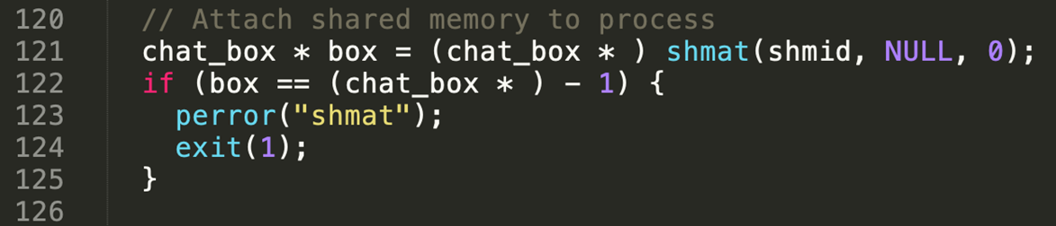
SHARED MEMORY AREA
When a user wanna join the box chat: attach the shared memory area which declared the chat_box to the user’s chat process

Slide 15
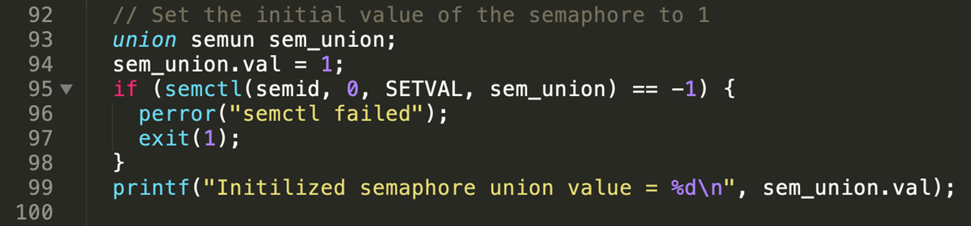
SEMAPHORE LOCK
Messages and users data saved in shared memory area
JUST 1 PROCESS CAN MODIFY IT AT ONE TIME
We use binary semaphore to lock the access of processes to the shared memory area
0 <= sem_union.val <= 1

Slide 16
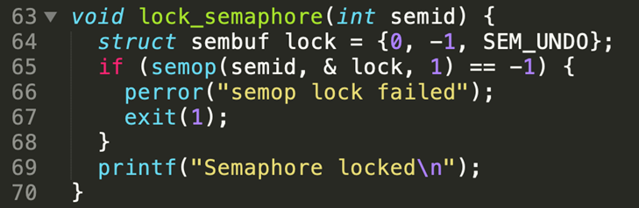
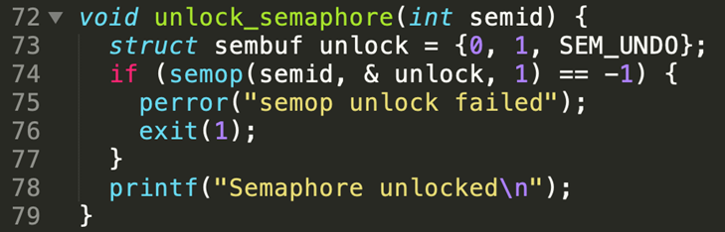
SEMAPHORE UNLOCK
We also provide lock and unlock function for the purpose of easy to use in processes
When ever process access to shared memory area:
Add a user
Save a message
We will lock then unlock after the modification done successfully

Slide 17
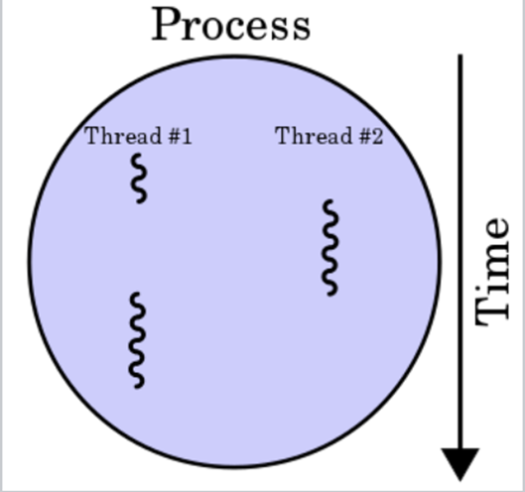
MESSAGE & DISPLAY
As each user represented by one process and each process have 1 main thread, we create another thread:
The main thread for the purposes of sending message
The sub thread for the purposes of display received message
→ Allow multi-tasking

Slide 18
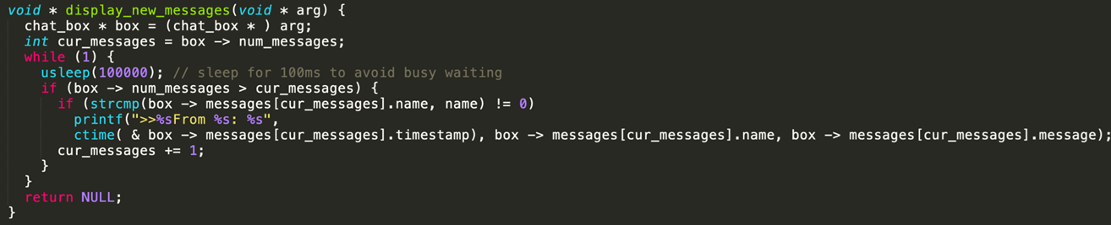
CHAT BOX - DISPLAY THREAD
Store a pointer point to the latest messages displayed
Not display the message of owner

Slide 19
THANK YOU FOR LISTENING

